Slide 1
Working with ros service

Slide 2
Working with ros service
Sometimes, using topic alone is not enough, we want to receive information back from the node we just sent information to
Examples: querying the state of a node; doing quick calculation for inverse kinematics
In those cases, we can use ROS services
*Prerequisite:
A catkin workspace has been set up
A package created with dependency on roscpp and std_msgs (use command: $ catkin_create_pkg <package_name> roscpp std_msgs in the /src folder of your catkin workspace)
For this case, we will use “simple_server_client” as the package name

Slide 3
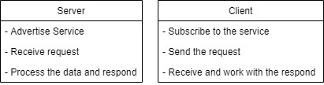
Server and client
In ROS service communication, we have a server and a client
Server and client are slightly different from publisher and subscriber, as shown below

Slide 4

Working with ros services
Since the standard ROS services are somewhat limited, we will move straight to using a custom service.
To create a new service, we must first define the service call request and respond using a .srv file (just like with topic communication)
In the next example we will have our service receive a string and counts the number of words in that string
Example of a .srv file:

Slide 5
Creating a custom srv file
Creating a custom service message
In your package, create a new folder named srv: $ mkdir srv (use $ cd ~/catkin_ws/src/<package_name> to navigate to your package)
Create a new text file in your srv folder and name it WordCount.srv (the name can be anything): $ gedit WordCount.srv
The content of the .srv must follow the format:
Starting from the beginning of the file, we have the request. This field can be empty
The request and respond are separated by “---”
After the separation line, everything else is the respond

Slide 6
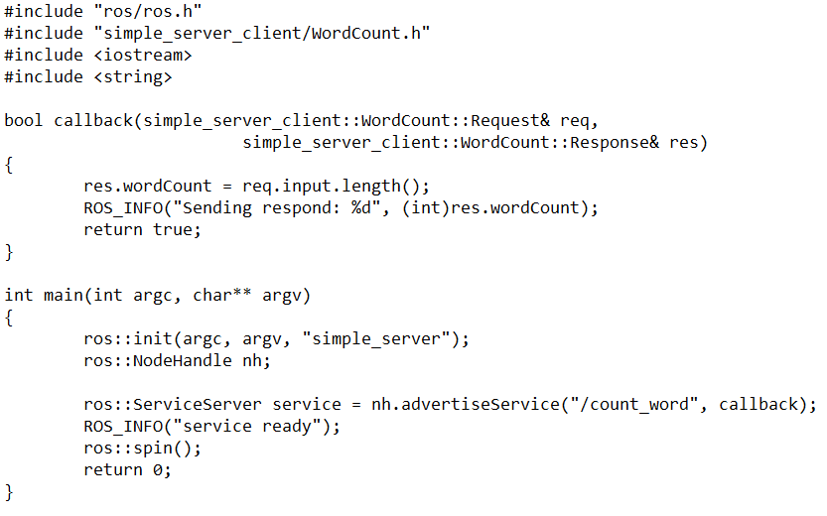
Server
Here is an example of a server
The server advertise its service, then wait for a client (ros::spin();)
Once a client calls, it goes to the callback function, work on the respond and return a bool, signifying a success call.

Slide 7
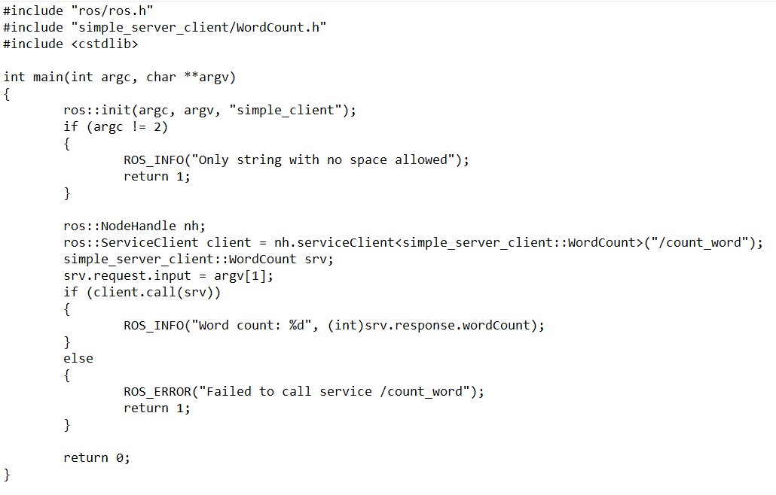
client
Here is an example of a client
The client setup the respond, then call for the service
If the connection is successful, the client will then work with the respond

Slide 8
Working with ros service
To send a custom service, we need add similar things to the CMakeList.txt file as we did with sending message.
find_package(catkin REQUIRED COMPONENTS roscpp std_msgs message_generation)
generate_messages(DEPENDENIES std_msgs)
catkin_package()
include_directories(include ${catkin_INCLUDE_DIRS})
add_server_files(DIRECTORY msg FILES WordCount.srv)
Add the following to the package.xml file
<build_depend>roscpp</build_depend> <run_depend>roscpp</run_depend> <build_depend>message_generation</build_depend> <exec_depend>message_runtime</exec_depend>

Slide 9
Build and run
We build the package and run the node:
Build the package with:
$ cd ~/catkin_ws
$ catkin_make
Run the nodes:
$ roscore
(in a different terminal) $ rosrun simple_server_client simple_server
(in a different terminal) $ rosrun simple_server_client simple_client

Slide 10
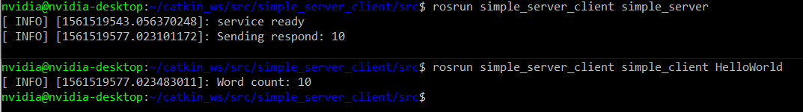
Working with ros server
Sample output of the example

Slide 11
conclusion
The communication using service is fast, one-to-many and bidirectional
The content of the reply should NEVER be modified directly as there can be multiple client subscribing to the same service. (There can only be ONE server for each service)
Communication using service should be used for small and fast tasks as it delay/stop the whole process from running

